Slide 1

Finally. A platform that pays YOU back.
While TikTok, Facebook, and Instagram made billions from your attention — NestDaddy pays you to be part of it. Premium news + recurring affiliate rewards = real value for users.

Slide 2

The problem: attention creates value — you get nothing
Attention extraction
Hidden opportunity cost
You generate content, engagement, and data — platforms monetize it, you don't.
Hours spent scrolling could become income or informed decision-making time.
People need extra income
Many users are searching for reliable, low-friction ways to earn recurring revenue.

Slide 3

The solution: NestDaddy
NestDaddy combines a premium, AI-powered news platform with a 5-tier recurring affiliate model. Real-time breaking news, deep AI insights, and a community-first commission structure — all for $5/month, cancel anytime.

Slide 4





Product highlights
Real-time news
AI-generated insights
Breaking alerts
Malaysia, Global, Financial sections updated continuously.
Instant notifications for major events and market moves.
Curated, concise analysis delivered 4x daily.
Crypto + sentiment (coming)
Real-time sentiment signals to complement price data.
Android app and enhanced personalization coming soon.

Slide 5

The opportunity: subscription + recurring affiliate rewards
Subscribe for $5/month, share with friends, and earn ongoing commissions through a 5-tier affiliate system. Community-first revenue sharing returns 50% of subscription revenue back to members.
Tier 1
Tier 2
Tier 3
25% commission — direct referrals
15% commission — referrals of your referrals
5% commission
Tier 4
Tier 5
3% commission
2% commission

Slide 6
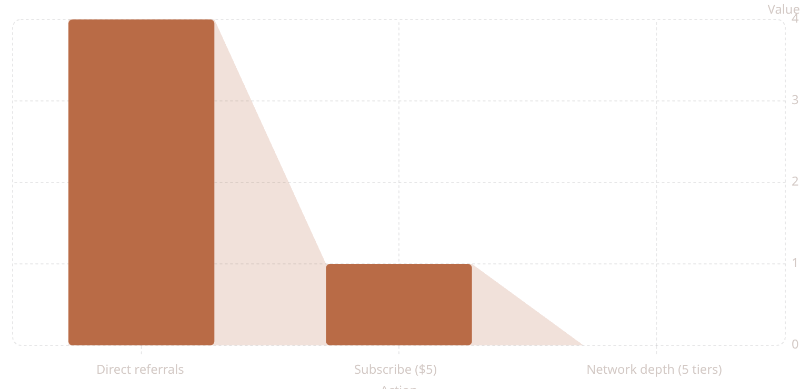
0%
The math — simple, compelling
Total conversion rate
Recruit 4 friends → your subscription becomes free forever (their payments cover your 25% Tier 1 revenue).
Recruit 10 friends → net positive earnings beyond your subscription cost.
Earn passively as your network recruits — commissions paid across 5 levels, ongoing.

Slide 7

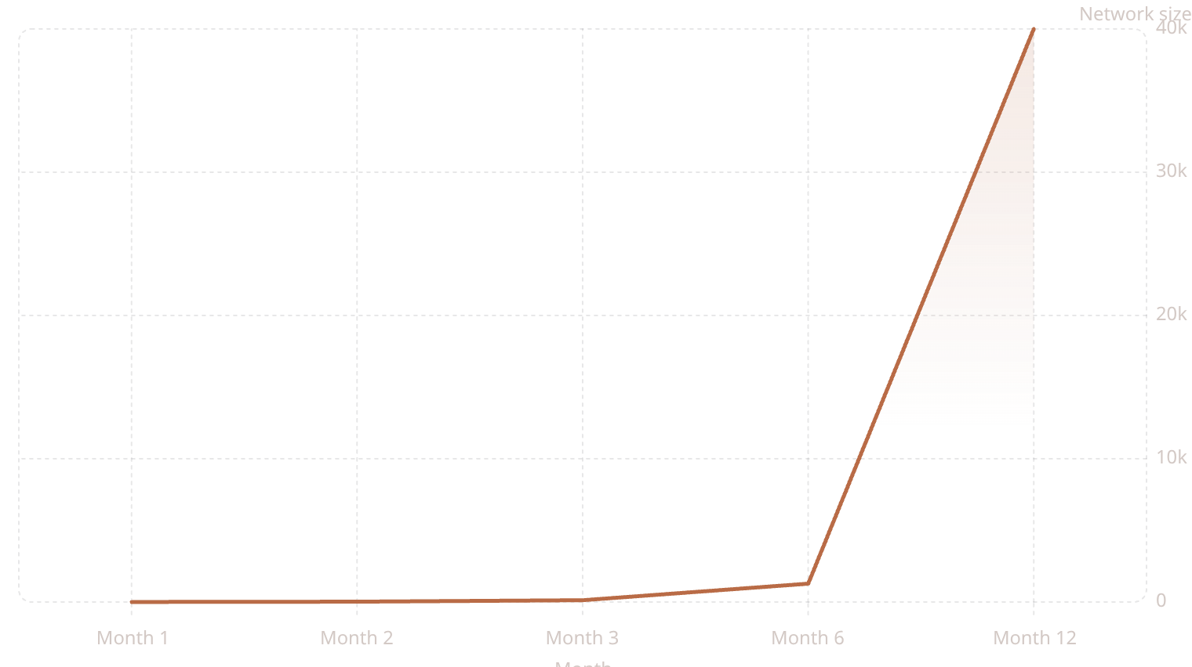

Compounding growth: modeled projection
Organic viral expansion from referral behavior drives exponential network growth and recurring revenue.
At scale, recurring $5 subscriptions multiply into meaningful, predictable payouts for early members and a durable revenue stream for NestDaddy.

Slide 8

Why members stay — retention mechanics
Retention is engineered through incentives, product value, and network effects.
Commission continuity
Price-protected growth
High value product
Commissions require activity; inactivity forfeits commission — incentivizes ongoing engagement.
If price increases, commissions rise proportionally — late churn doesn't erode early member gains.
Premium AI insights and personalized dashboards make $5 compelling to keep.

Slide 9

Why NestDaddy wins
Not another attention sponge
TikTok: creators generate value; platforms retain the upside.
Not an overpriced MLM
MLMs sell products at markup — NestDaddy sells a real, valuable service at a fair price.
Not speculative crypto
Crypto can be volatile and abstract — NestDaddy delivers tangible product value and recurring cash flow.
Community-first model
50% of subscription revenue flows back to the user community through a transparent affiliate structure.

Slide 10

The vision — practical, scalable, global
1
Today — Malaysia
Launch, product-market fit, community seeding.
2
Year 1 — ASEAN
Localized content, partnerships, mobile apps.
3
Year 3 — Global
Scale to 1M subscribers — life-changing income for early members and durable ARR for NestDaddy.
Join now: Be part of the first platform that pays YOU back. Subscribe at nestdaddy.com — $5/month. Share. Earn. Grow. Forever. Early members capture the largest share of upside.

