Slide 1



Get Paid to Read the News
Subscribe to your country's top news. Refer just 2 friends. Cover your cost — forever.
Premium, local journalism
Passive income
Start free
No-risk signup. Try NestDaddy and test the referral flow.
Simple referral system turns reading into recurring earnings.
Curated from verified local sources in your country — fast and trustworthy.

Slide 2


You're drowning in noise
Fake news everywhere
Hard to trust sources — misinformation spreads fast and wastes your time.
Generic, global-first feeds
International headlines dominate; your country’s stories get buried.
Earnings gap
You consume content daily but earn $0 — readers should be rewarded.

Slide 3
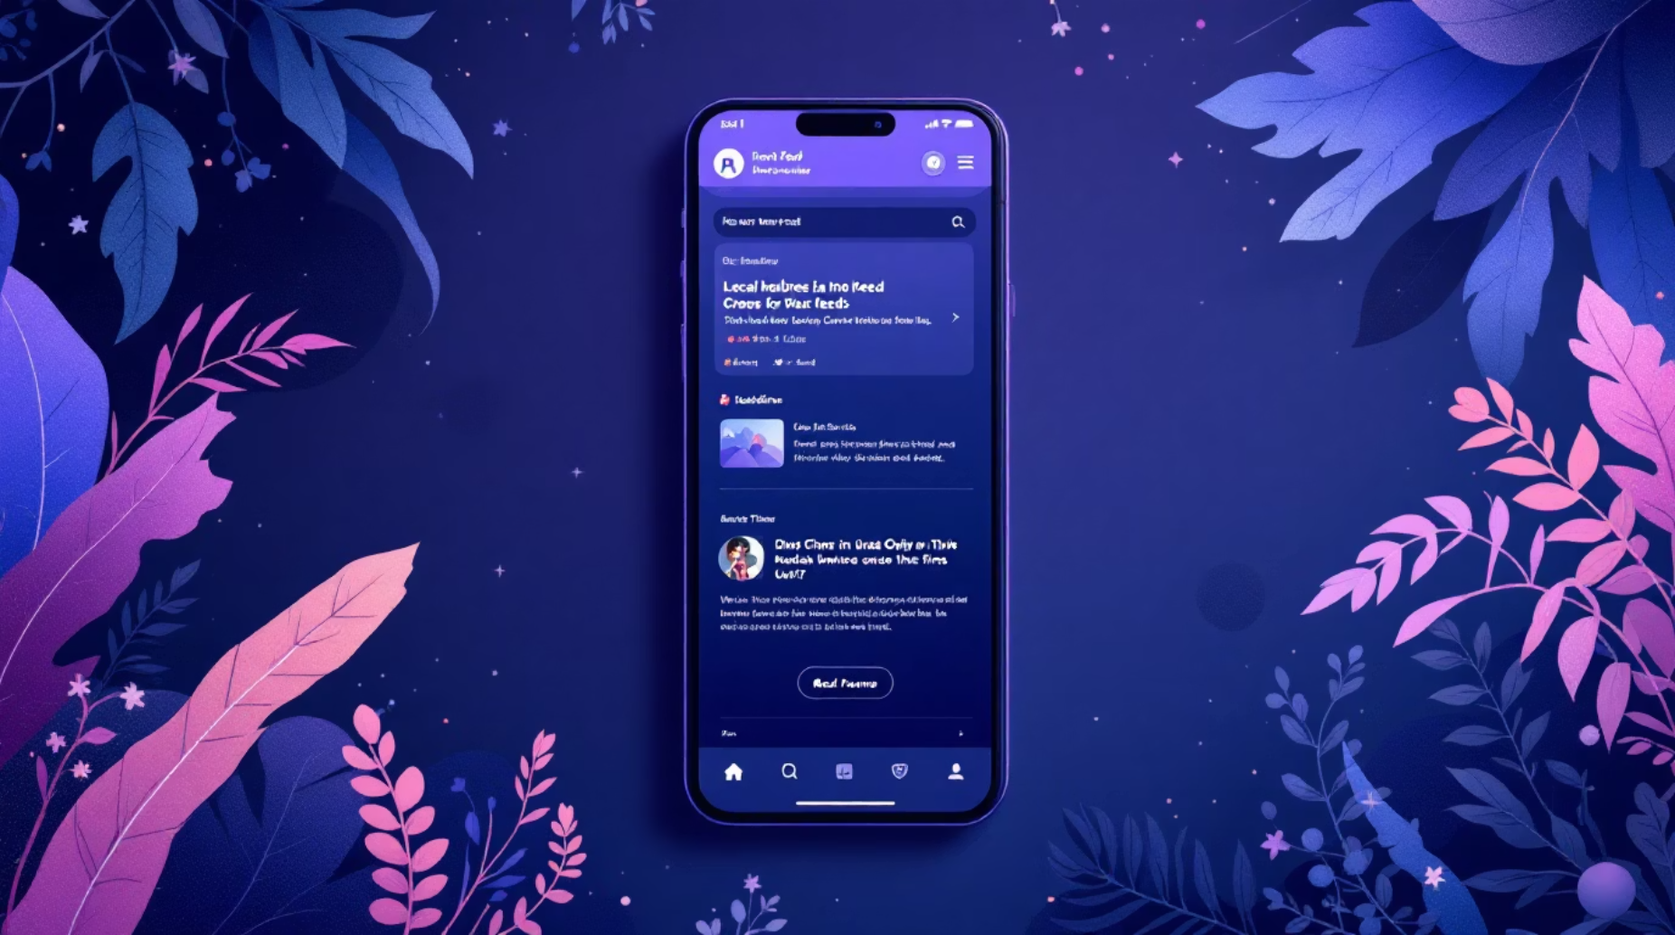
NestDaddy — Your Country. Your News. Your Income.
Verified local sources
Real reporting from trusted publishers in your country — no guesswork.
Regional coverage
Malaysia, Indonesia, Korea, Singapore, Thailand, Philippines & more.
Near real-time updates
Updated every 5 minutes across 46+ countries — stay informed instantly.

Slide 4











Choose Your News Category
Select the country or topic that matters to you — $10/month per category.
🇲🇾 Malaysia
🇮🇩 Indonesia
🇰🇷 South Korea
🇸🇬 Singapore
🇹🇭 Thailand
🇵🇭 Philippines
Global News
Tech News
Financial News
Football
Price: $10/month per category — choose one or stack multiple categories.

Slide 5

Refer 2 people. Your subscription pays itself.
You pay
Referral commission
Pairing bonus
$10 / month
Balanced pair bonus = $5.00
2 × $2.50 = $5.00
Total earned
$10.00 / month → NET COST = $0
After that? Every new person in your network is pure passive income — month after month.
Just 2 people. That's all it takes to go from subscriber to earner.

Slide 6
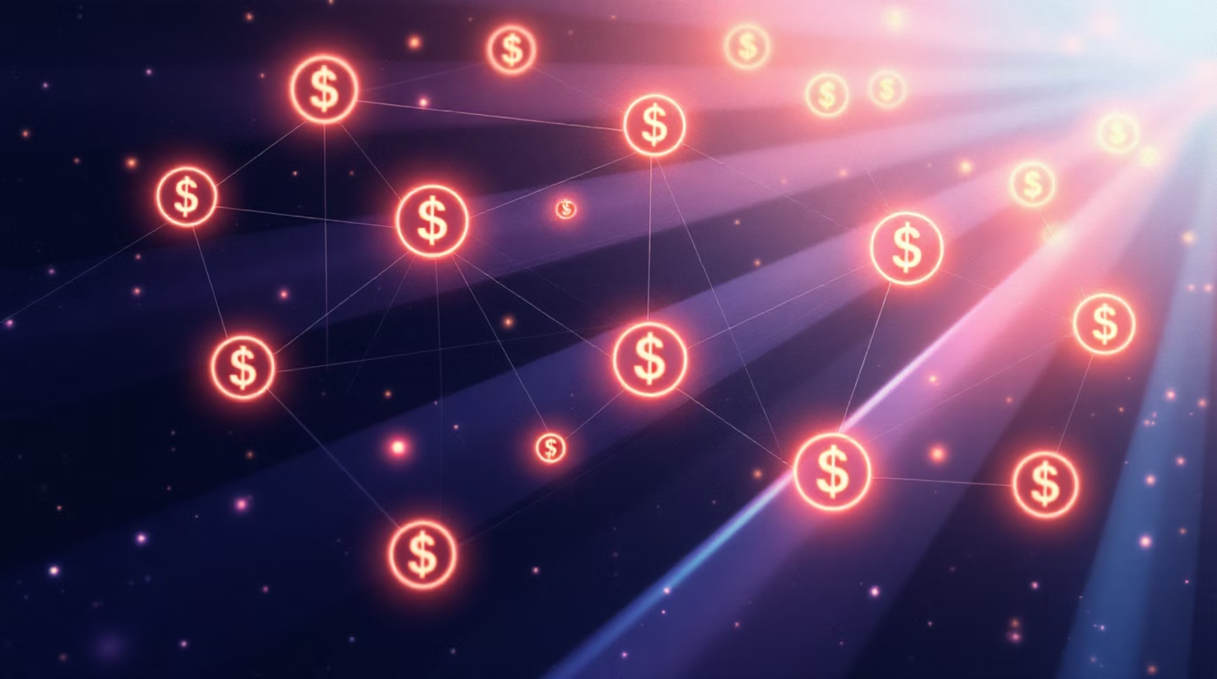
But why stop at 2?
Automatic earnings
Earn up to 50% in referral rewards — 5 levels deep. Your 2 friends each refer 2 more, they refer 2 more, and you earn automatically from the whole group every month.
Earnings compound as your downline grows — no extra work.
5 levels
Rewards paid from direct and indirect referrals for ongoing income.
Scales with virality
Small starts can create large networks — power of exponential growth.

Slide 7
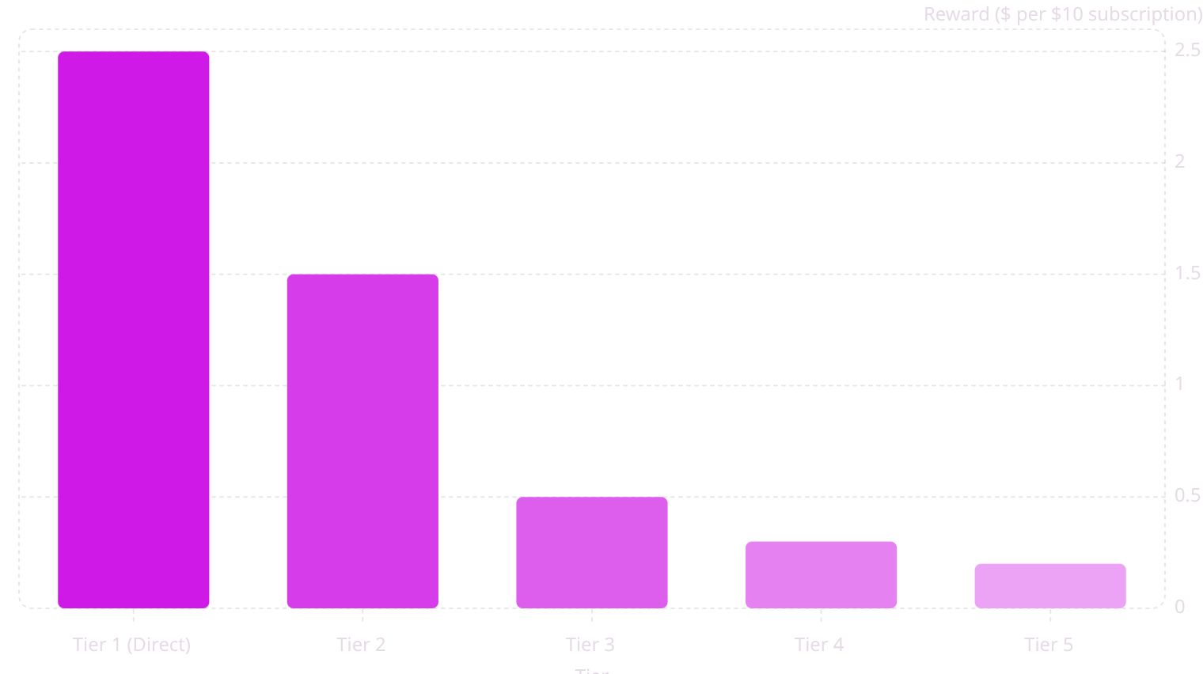
5-Tier Referral Reward System
The system pays 50% total of each $10 subscription to your network every month. Recurring. Not one-time.

Slide 8




What does this look like in real money?
Starter
Growth
Viral
Each refers 2 → 62 people in network → $26.20 / month
Each refers 3 → 363 people → $107.40 / month
Each refers 15 → 813,615 people → $169,125 / month
Remember — it starts with just 2. That's your break-even. Everything beyond that is wealth.

Slide 9

We place your referrals FOR you
Auto binary placement
Weekly Pairing Bonus
24/7 earnings
Downline commissions are calculated and paid automatically — even when you sleep.
The system finds the optimal spot in your network so you don’t have to think about structure.
Every time you balance a left & right leg, earn $5 per pair — credited weekly.

Slide 10
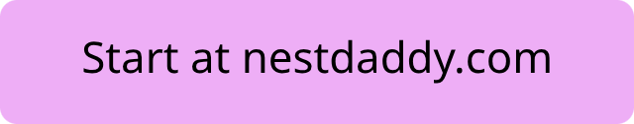


2 friends. Break even. Build wealth.
The only question is — how far do you want to grow?
3. Watch your network
2. Refer 2 friends
Earn passively every month as your network grows — recurring income, forever.
1. Subscribe
Cover your cost in month 1 — simple shares, messages, or your referral link.
$10/month — pick your country's news and start reading quality local reporting.
Early movers build the deepest networks. The best time to join is now.

