Slide 1

NestDaddy Affiliate Program
How You Earn Commission + Pair Bonus

Slide 2





The Foundation
One Subscription. Five Levels of Income.
Every Member Pays $10/Month
$5.00 Flows to Network
Consistent monthly subscription fee from every participant in the network
50% of each subscription flows directly into the affiliate network
Automatic Monthly Earnings
5 Levels of Referrers
Money reaches up to 5 levels of referrers above each new member
You earn every time anyone in your 5-level network subscribes — passive and automatic

Slide 3
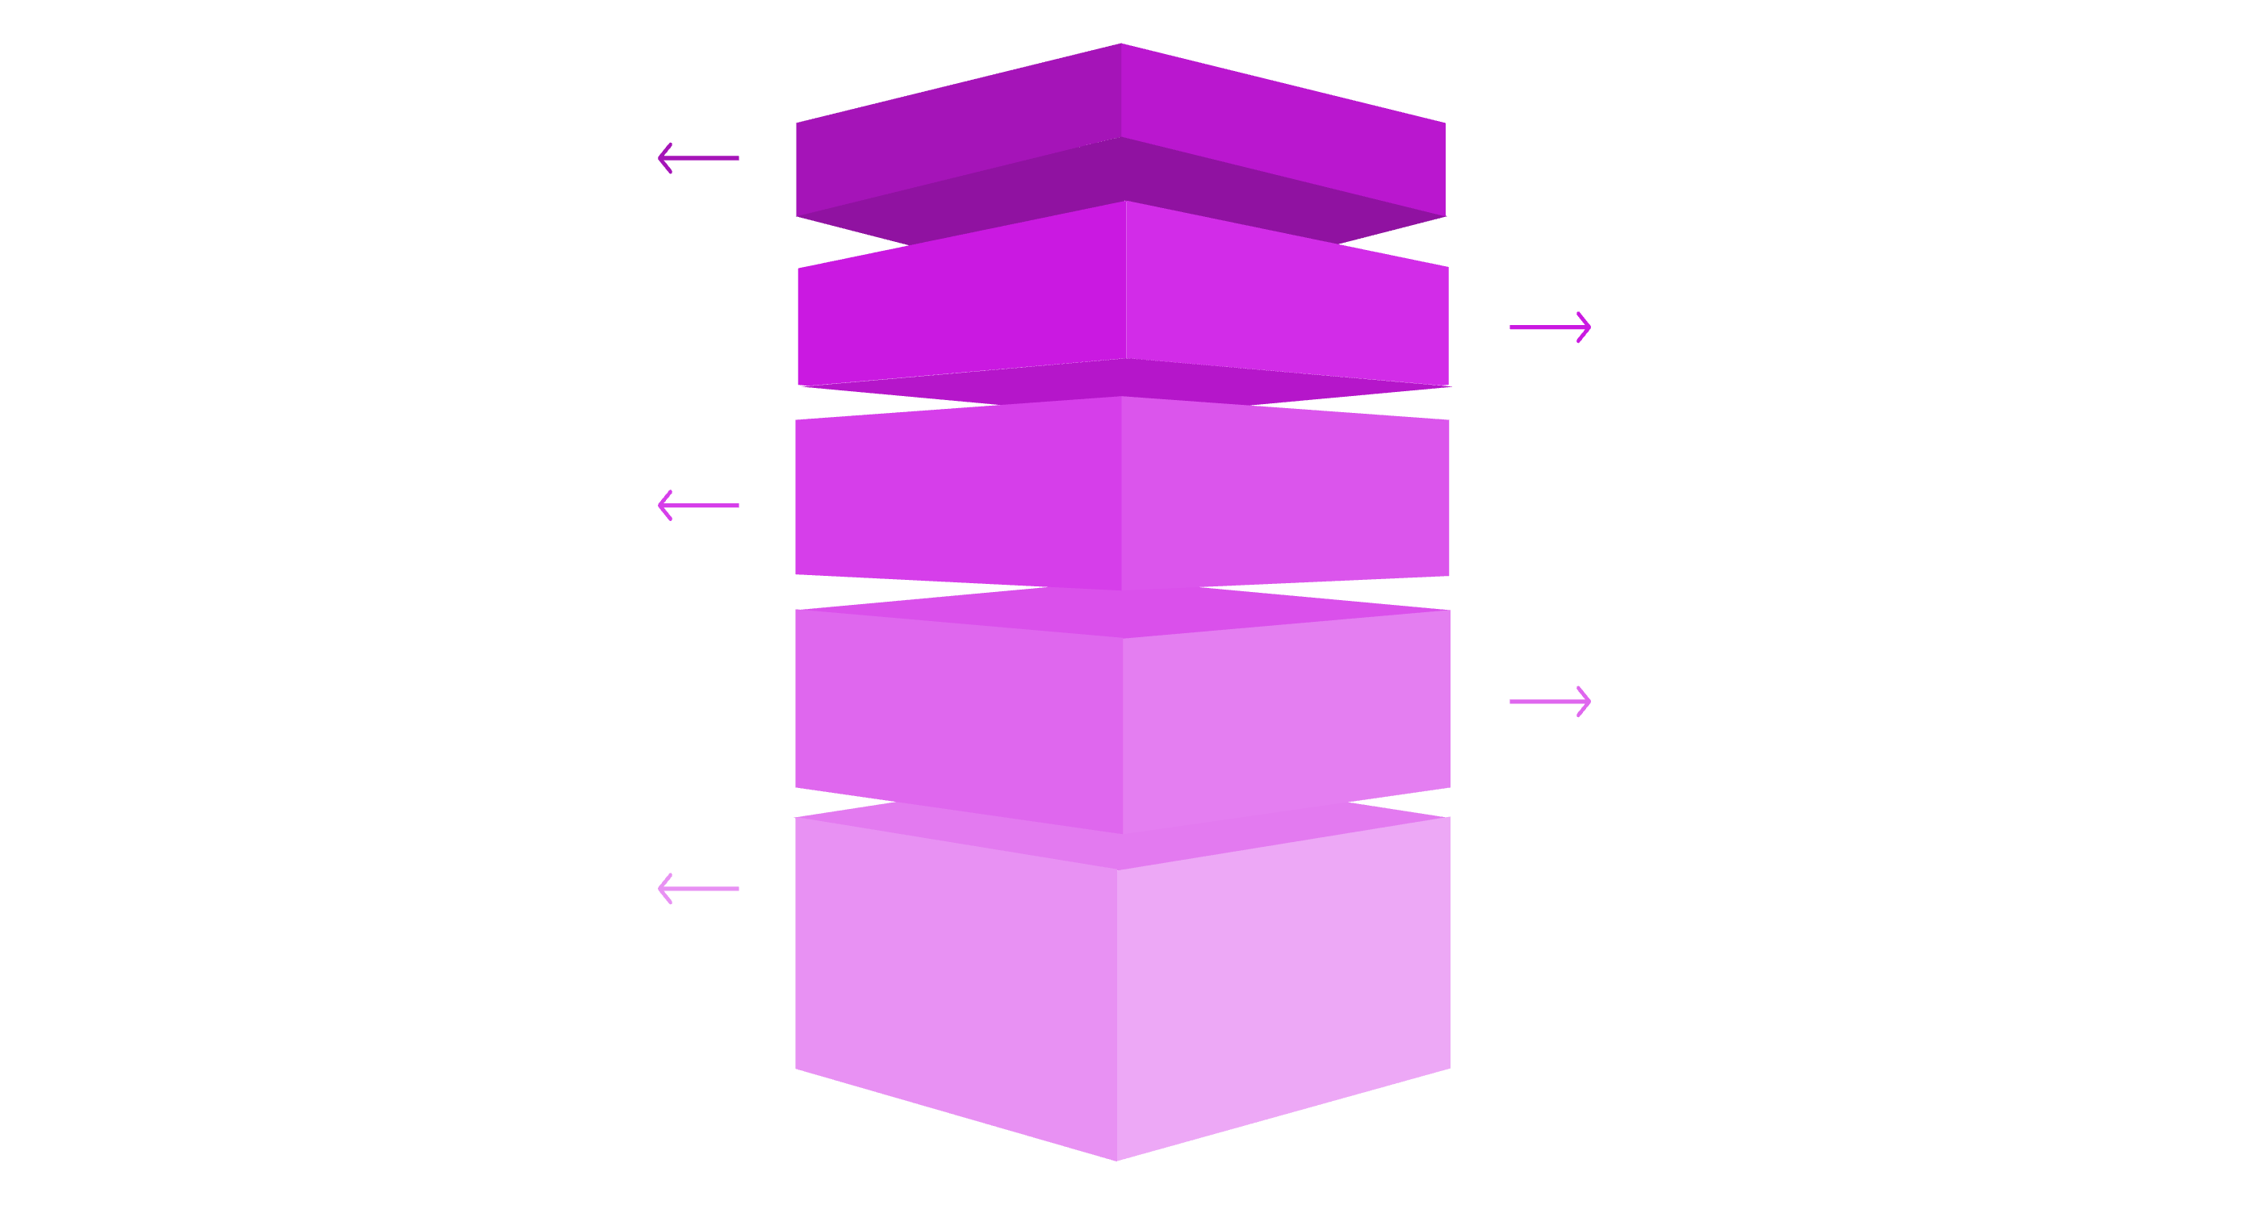
Your Network = A Binary Tree
YOU (Root)
Top of your network tree.
Left & Right Teams
Two primary branches beneath you.
Level 3
Four nodes expanding outward.
Level 4
Eight active members (green).
Level 5
Sixteen active members (green).
YOU are at the top of your own network tree. Every person you refer goes into either your LEFT team or RIGHT team.
Their referrals build deeper under them, and the tree grows down 5 levels. Each level expands exponentially, creating multiple earning opportunities.

Slide 4
Your 5-Tier Commission Structure
Level 1 — Direct Referrals
25% — $2.50 per member you refer directly
Level 2 — Your Referrals' Referrals
15% — $1.50 per member in second level
Level 3 — Third Generation
5% — $0.50 per member in third level
Level 4 — Fourth Generation
3% — $0.30 per member in fourth level
Level 5 — Fifth Generation
2% — $0.20 per member in fifth level
TOTAL: 50% = $5.00 per subscription distributed across your 5-level network

Slide 5





Every Subscription Pays Up the Tree
New Member Joins
Member A joins under Member B at Level 1
Level 1 Earns $2.50
Member B receives their direct commission
Level 2 Earns $1.50
Member B's upline receives their commission
Continues Up 5 Levels
Each level up earns their percentage automatically
Passive. Automatic. Monthly. Your commissions accumulate with every new subscription in your network.

Slide 6

The Pair Bonus
Balance = Bonus
How It Works
Real Examples
Every time you have 1 person on LEFT + 1 person on RIGHT = 1 Pair
Left 1, Right 1 = 1 pair = $5.00
Left 3, Right 3 = 3 pairs = $15.00
Left 5, Right 3 = 3 pairs = $15.00 (smaller side counts)
Each pair earns you $5.00 bonus
Pairs are based on the SMALLER side (minimum of left/right)

Slide 7
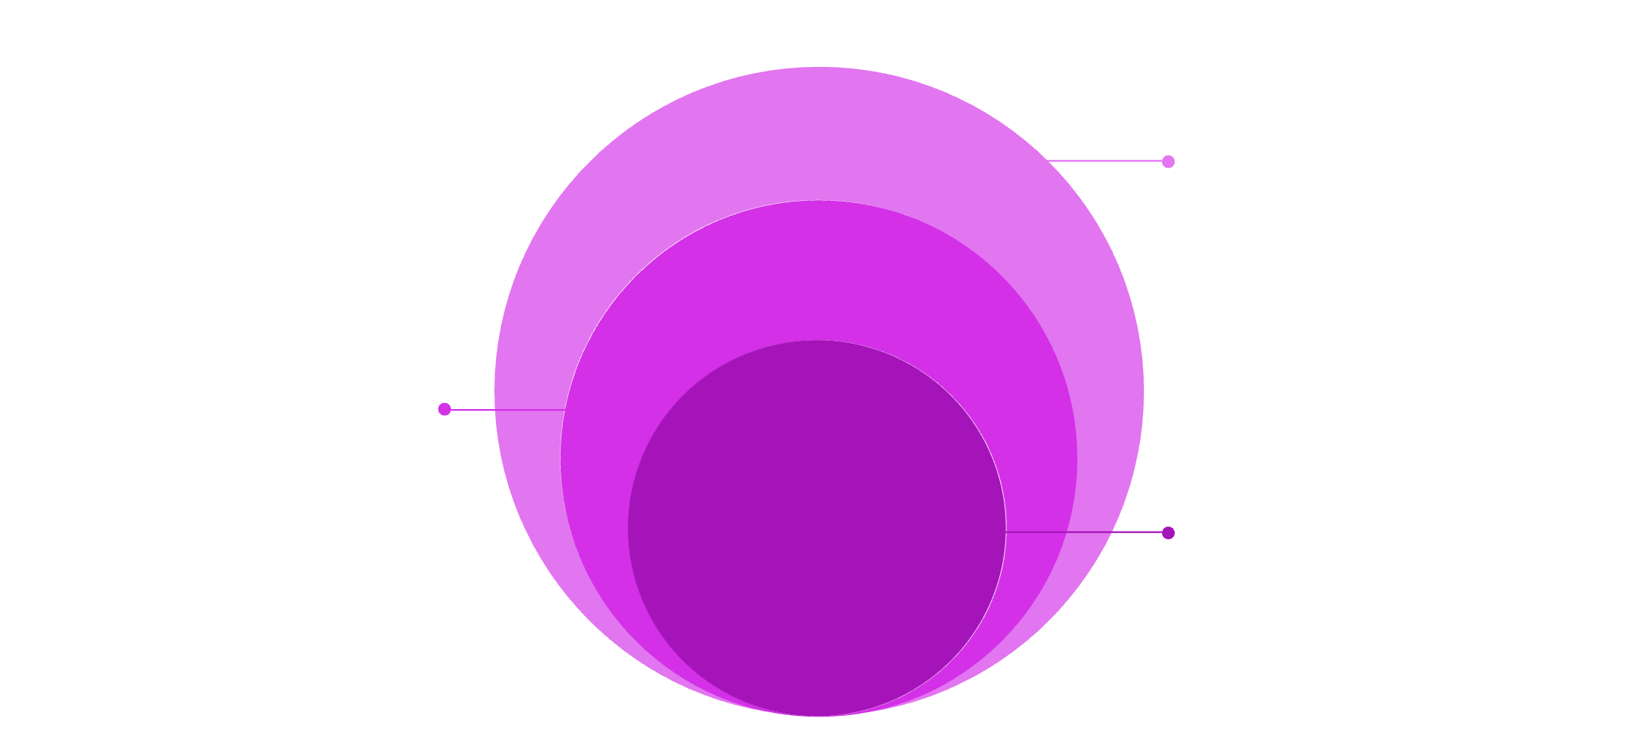
Scenario: Everyone Refers Just 2 People
Monthly Earnings
$26.20/month from the 5-level tree
Layered Growth
Levels: 2,4,8,16,32 members
Core Network
62 total members across 5 levels
$5.00
$6.00
$4.00
$4.80
Level 1
Level 2
Level 3
Level 4
2 members × $2.50
4 members × $1.50
8 members × $0.50
16 members × $0.30
$6.40
Level 5
32 members × $0.20
$26.20/Month
Earned from just 62 people in your 5-level network

Slide 8
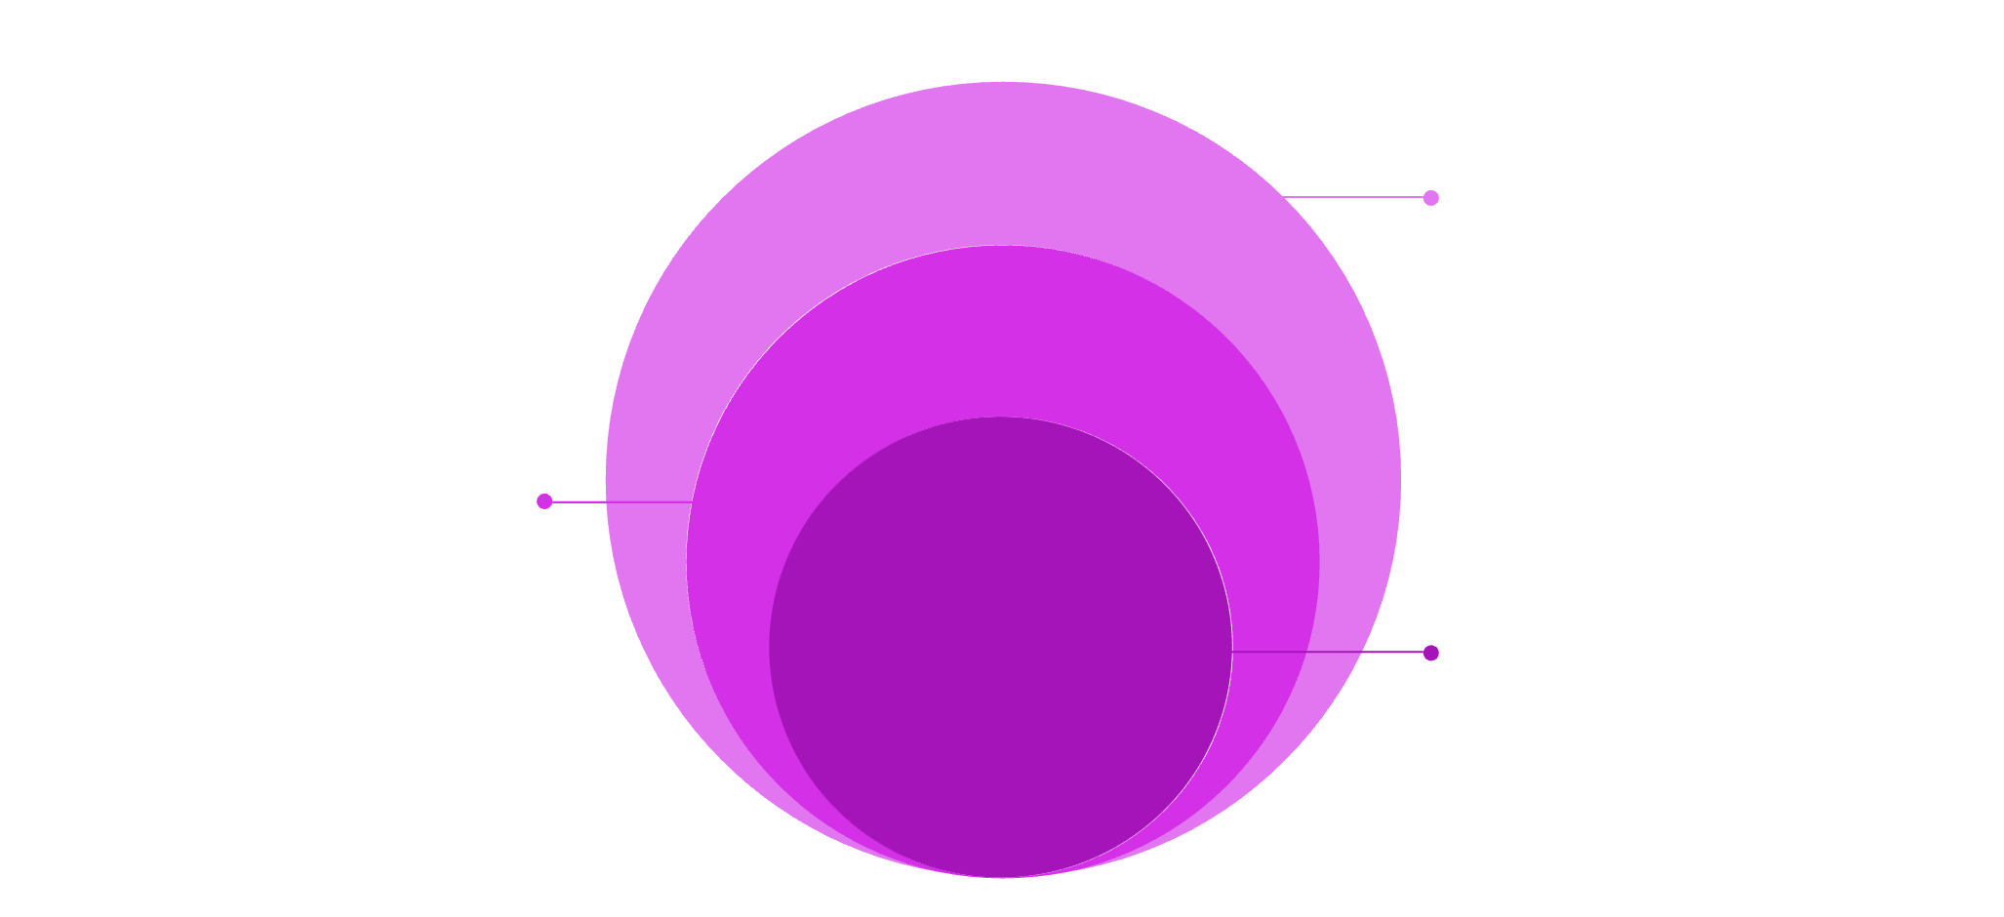
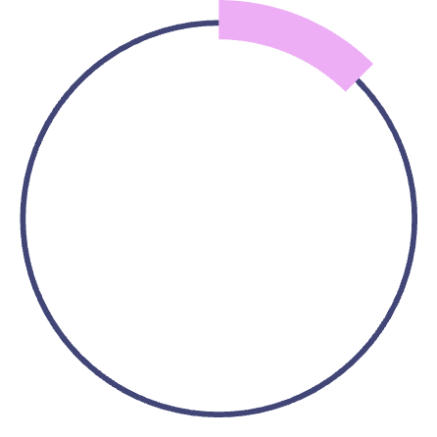
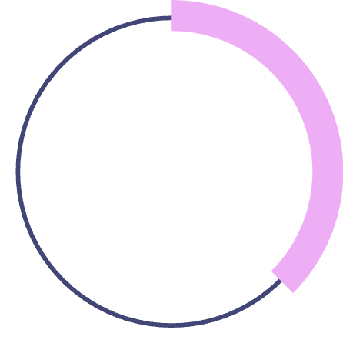
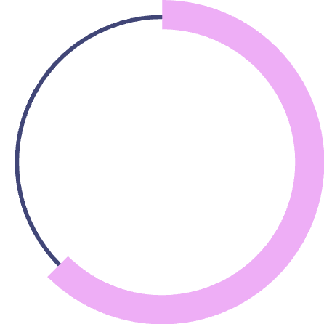

Scenario: Everyone Refers 5 People
Outer: Level 1 & Total
5 members; total 3,905 people
Middle: Levels 2–4
25, 125, 625 members expanding reach
Core: Level 5
3,125 members — deepest growth
$12.50
$37.50
$62.50
Level 1
Level 2
Level 3
5 × $2.50
25 × $1.50
125 × $0.50
$187.50
$625.00
Level 4
Level 5
625 × $0.30
3,125 × $0.20
$925.00/Month
Generated from 3,905 people across your network

Slide 9
BEAST MODE
Everyone Refers 20 People
$50.00
$600.00
$4,000.00
Level 1
Level 2
Level 3
20 × $2.50
400 × $1.50
8,000 × $0.50
$48,000.00
$640,000.00
Level 4
Level 5
160,000 × $0.30
3,200,000 × $0.20
$692,650/Month
From 3,368,420 people in your 5-level network

Slide 10


3 Steps to Start Earning
01
02
Subscribe
Share
$10/month unlocks your affiliate account and gives you instant access to your unique referral link
Send your referral link to your network via email, social media, or direct outreach. The easier you make it, the faster you grow
03
Earn
Commissions + pair bonuses paid automatically every 1st of the month. Watch your earnings grow with every new subscription

